Slide 1
Capstone Presentation

Slide 2
Objectives
Compilation of what constitutes a corruption risk indicator
A summary of the types of data existing
Some literature reviews and summarizes examples of corruption data from social media

Slide 3
Corruption Risk Indicator

Slide 4
Corruption Perceptions Index
The Corruption Perceptions Index is a global indicator that measures the perceived levels of public sector corruption.
It ranks 181 countries and territories worldwide based on perceptions of public sector corruption, using data from 101 external sources, including the World Bank, the World Economic Forum, private risk assessment firms, research centers, and more.
The results reflect the opinions of experts and businesspeople.

Slide 5
Aspects of Corruption Covered
The aspects of corruption covered by the index include:
Bribery.
Embezzlement of public funds.
Public officials exploit their positions for personal gain without consequences.
Governments' ability to curb corruption and enforce effective mechanisms for upholding integrity in the public sector.
Excessive bureaucracy, which increases opportunities for corruption.
The difference between appointments based on merit and those based on favoritism in the public sector.
Protection for whistleblowers, journalists, and investigators when reporting bribery and corruption cases.
Control of the state by individuals with narrow personal interests.
Civil society's ability to access and obtain information related to public affairs.

Slide 6
Data Inclusion
To be included in the ranking, a country must be featured in at least three sources of the Corruption Perceptions Index data.
If a country is not listed, it does not necessarily mean there is no corruption; rather, there may be insufficient data about it.

Slide 7
Data Sources
The index uses data from various institutions, such as the Bertelsmann Foundation, the Economist Intelligence Unit, Global Insight, and more.
It includes sources that provide ratings for a group of countries, measuring expert perceptions of corruption in the public sector.

Slide 8
Scope Limitations
The index does not supply a comprehensive view of corruption in any specific country; in this case, Lebanon.
It reflects perceptions of corruption in the public sector from the perspective of business professionals and country experts.
The scope of the Corruption Perceptions Index is limited.

Slide 9
Understanding Score vs. Rank
Country’s corruption score: The perceived level of public sector corruption.
Country’s corruption rank: The Country's position relative to other countries in the index.

Slide 10
Existing Data Types

Slide 11
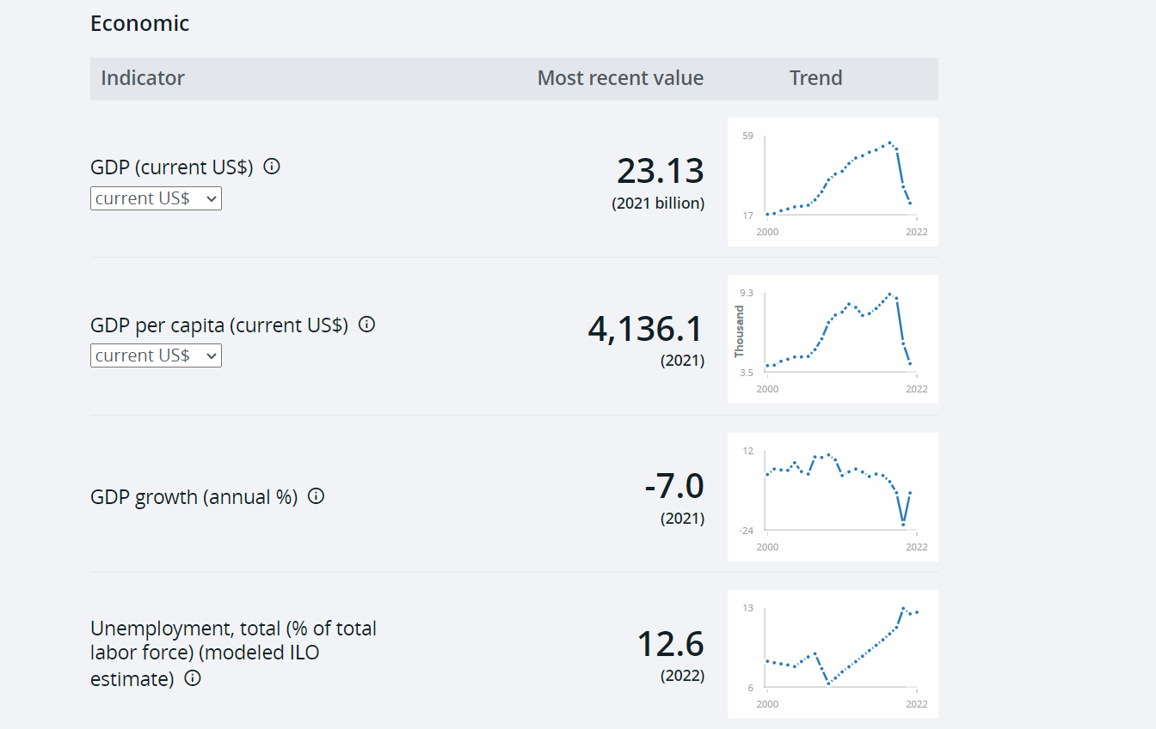
Graphs and Tables on Statistical data (Judiciary, Income Data, Lands Owned by Political Figures, Banks, etc...)

Slide 12
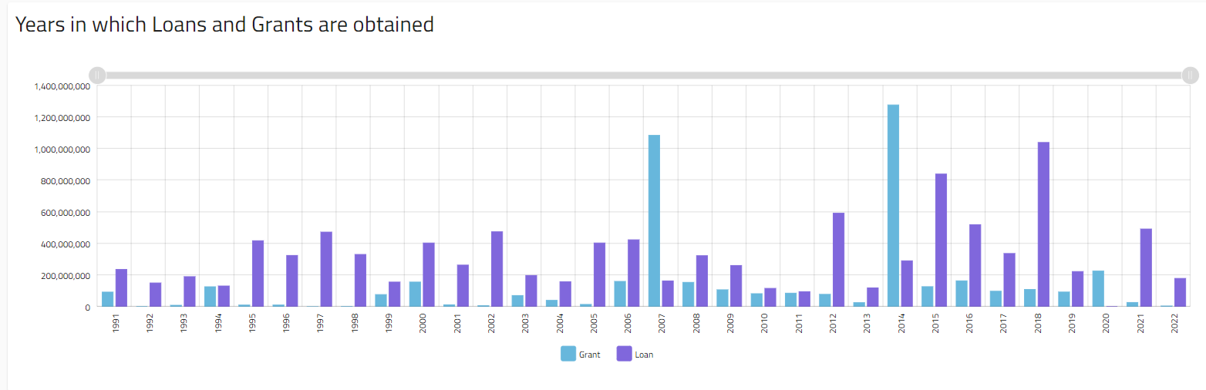

Slide 13
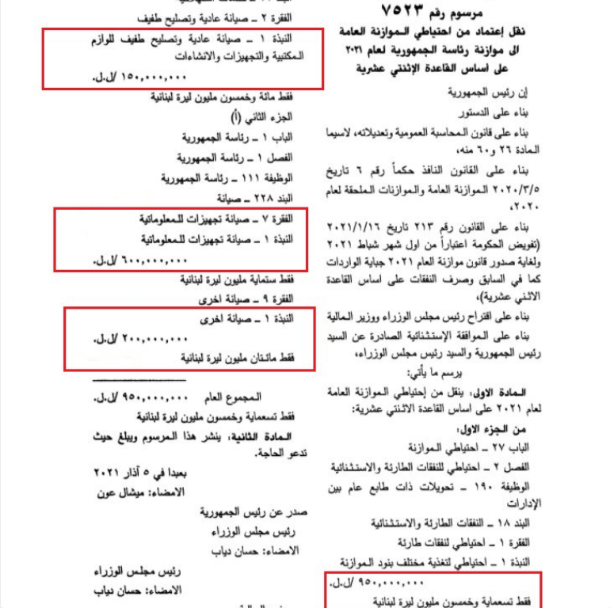
:سندات/مراسيم
Example in Picture:
“Transferring an amount of 950 million LBP from the "reserve for emergency expenses" to the Lebanese Presidency account to pay for "maintenance" costs.”

Slide 14
Research Papers / Publications:
https://mounirmahmalat.com/publications/

Slide 15
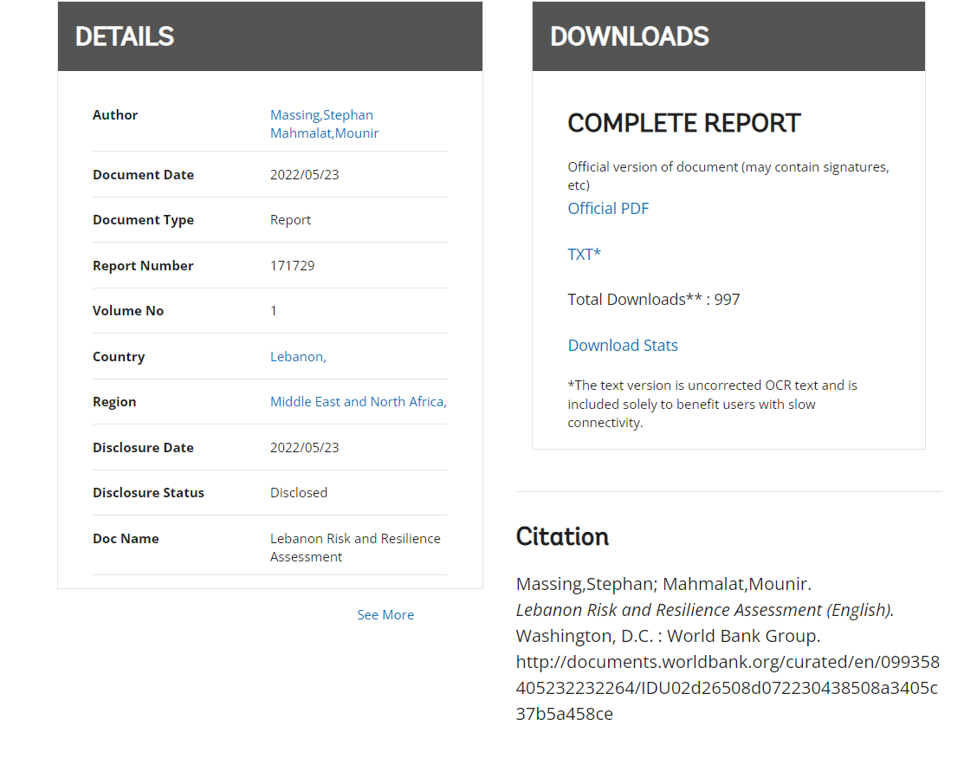
Reports:
Notes:
Refer to that pge and extract the categories

Slide 16
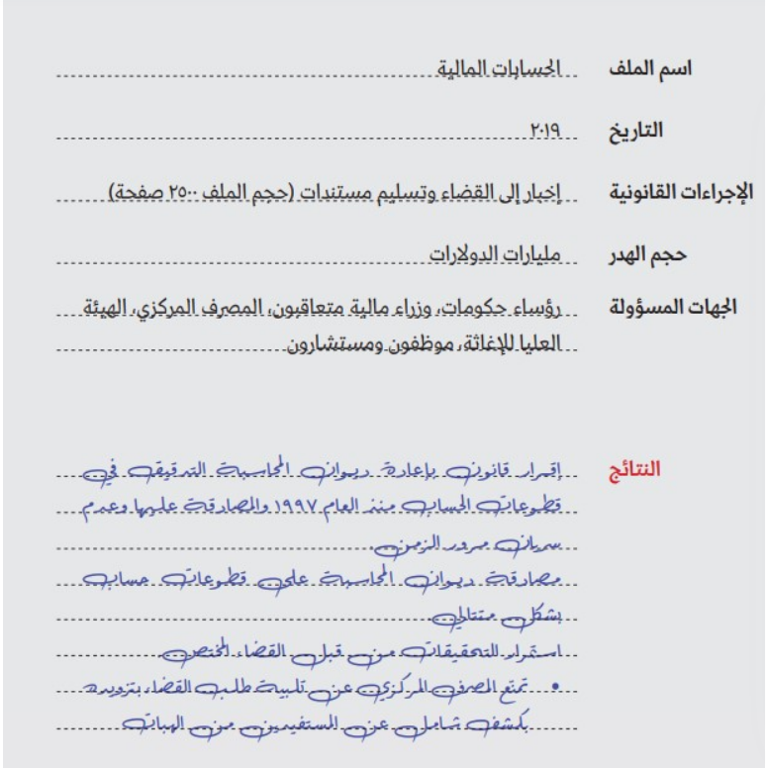
ملفات مالية

Slide 17
Data From Social Media
https://mailaub-my.sharepoint.com/:w:/r/personal/hmd26_mail_aub_edu/_layouts/15/Doc.aspx?sourcedoc=%7BA184E569-0A6A-4DF1-A61C-9652D9E6456D%7D&file=Proposal%20Capstone.docx&action=default&mobileredirect=true

